Slide 1
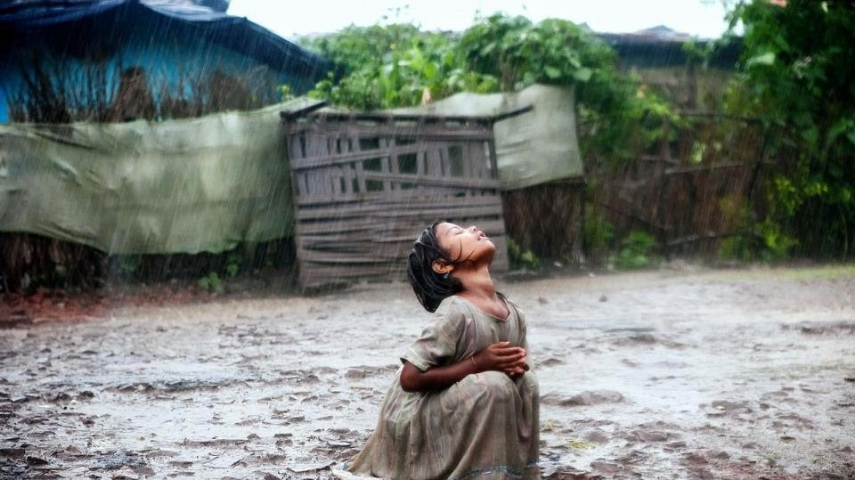
THE VULNERABILITY OF THE PERSON Identity, danger and strength
Belen Roma Romero
Ernesto Cavassa, s.j.

Slide 2
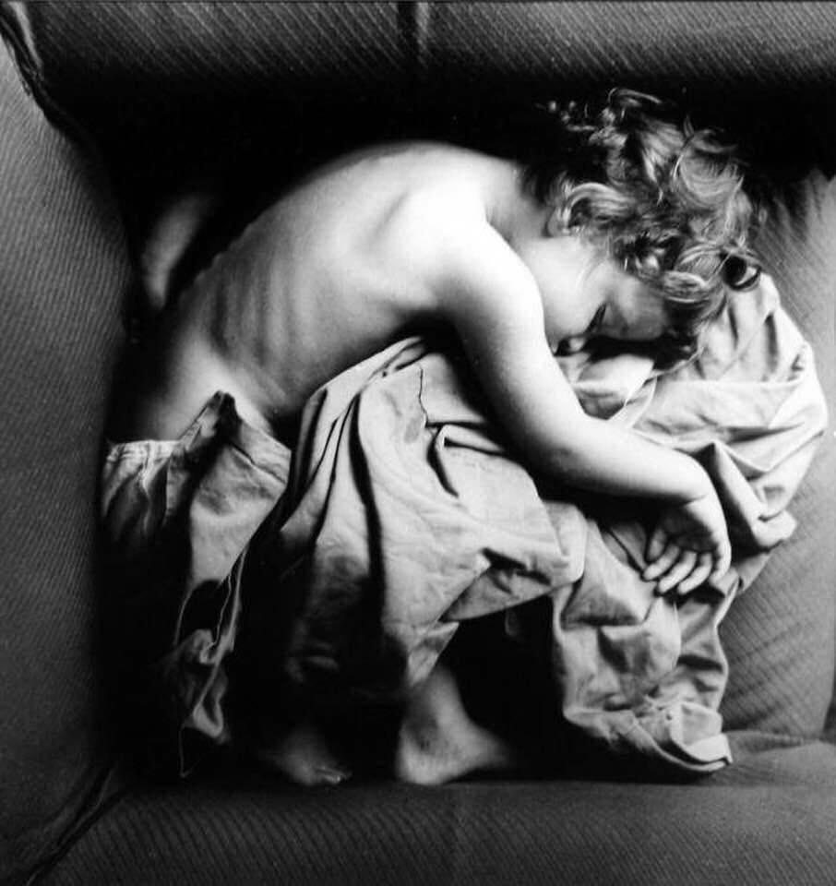
We are going to work with an image “being a baby”.
And it is that we have all been babies in our history
But it is also a metaphorical image: human vulnerability imagined as a baby , in my own hands or in the hands of others.

Slide 3
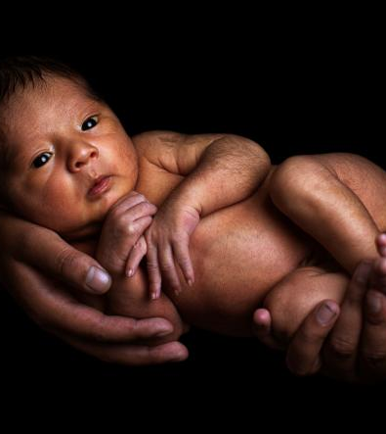
“Faith leads the believer to see in the other a brother who must SUPPORT AND LOVE. By faith in God, who created the universe, creatures and all human beings —equal by his mercy—, the believer is called to express this human brotherhood, protecting creation and the entire universe and helping all people, especially the most needy and poor”
Document on the human brotherhood for world peace and common coexistence. Feb 2019

Slide 4
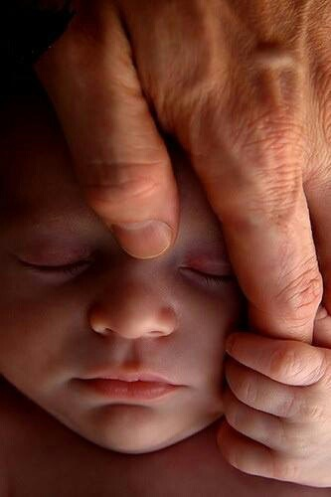
We are the species in the world most in need of connection and care to survive Since before birth and for many years, we need "another" to live We are vulnerable creatures in need of interconnection to live: the person in the center

Slide 5
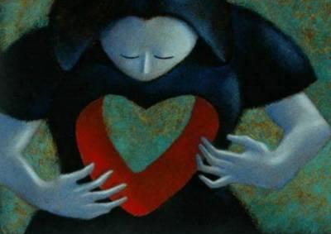
THE VULNERABILITY OF THE HUMAN BEING
A SHARED HUMANITY
It places us before the miracle of life making its way…..
but also in the face of the confusion that the pain and suffering of being vulnerable (“being damaged”) generates in us.
It tells us about the strength of caring for ourselves as a species, of being compassionate but also of the power to cause harm to each other ("harm") in everyday life.

Slide 6
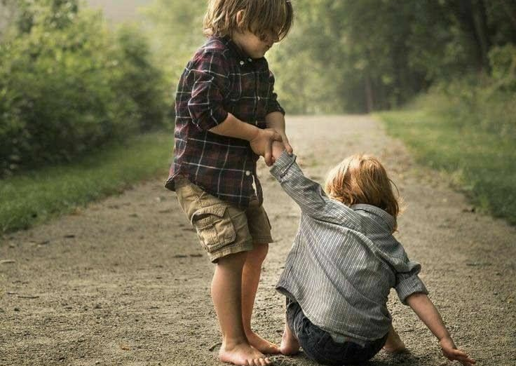
Being able to be "cared for, calmed and comforted" is paradise for the human being. Both receiving it and knowing how to give it to others and to oneself.
Human fraternity is recognizing the other as a vulnerable creature in need of ties that care for their "Humanity": it is the interconnection that makes us feel "part of"

Slide 7
We are going to work with an image “the babies”.
And it is that we have all been vulnerable babies
It is also a metaphorical image: human vulnerability imagined as a baby, in my own hands or in the hands of others.

Slide 8
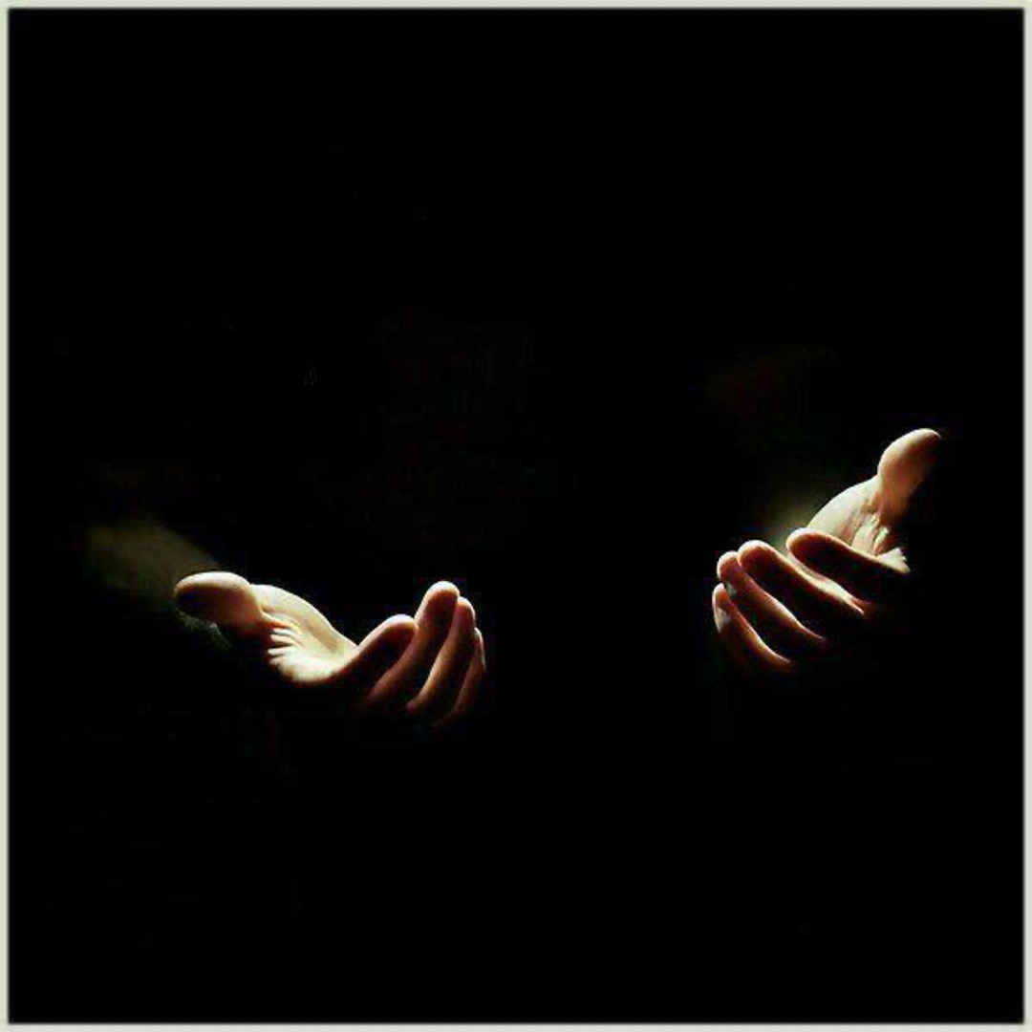
I invite you to spend a little while in the hands of a God who takes care of our vulnerability... or in the careful hands of the person you want

Slide 9
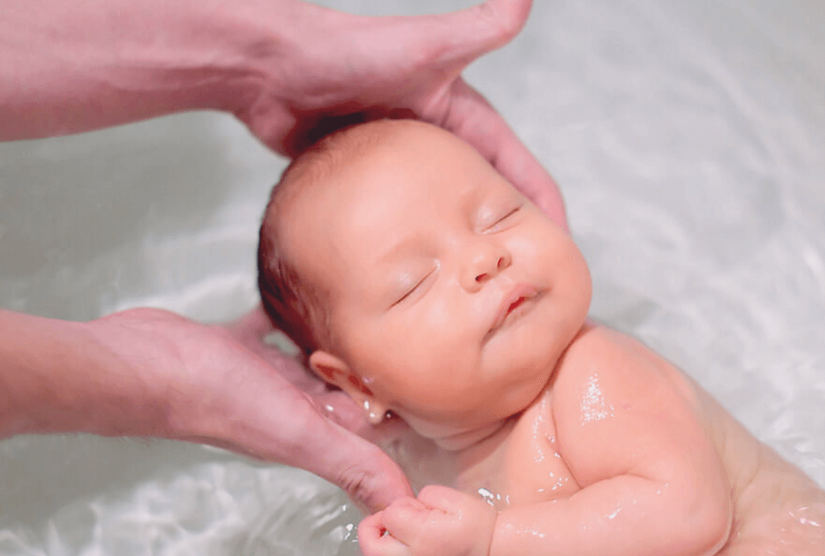
Video https://www.youtube.com/watch?v=tldAI_85IQI

Slide 10
Before our loved ones, those of my tribe, it is usually easier to take off our shoes in the face of their vulnerability

Slide 11
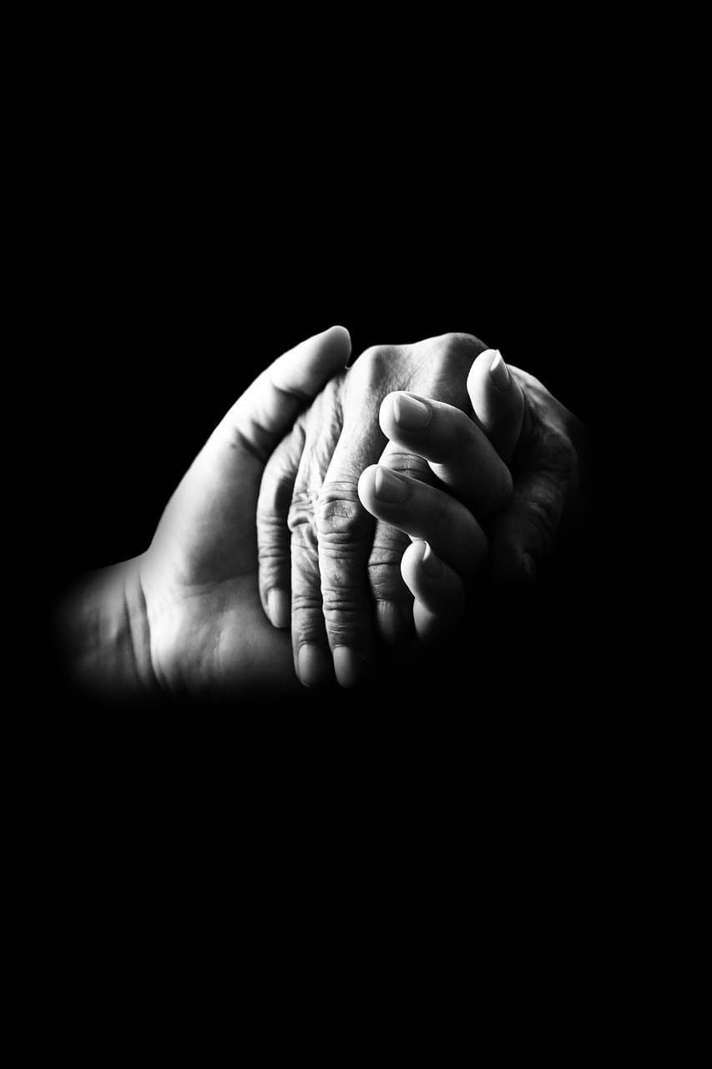
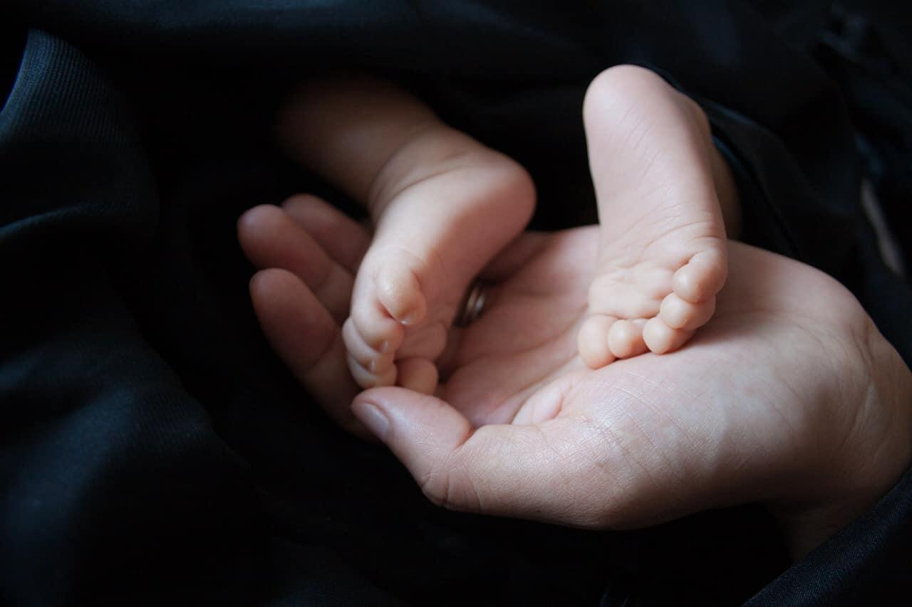
And the desire to embrace is born, to caress with the soul that vulnerability

Slide 12
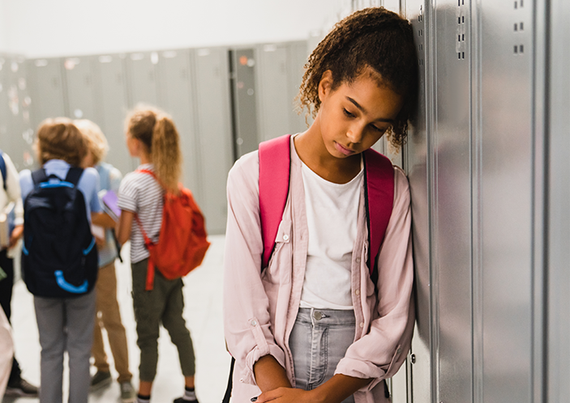
Even so…. we can do a lot of damage among those we consider to be "ours" Things get much more complicated when I don't feel the other is part of a “we ”, when I don't agree, I don't like it or I consider it a “danger”. There it is easier to dehumanize him

Slide 13
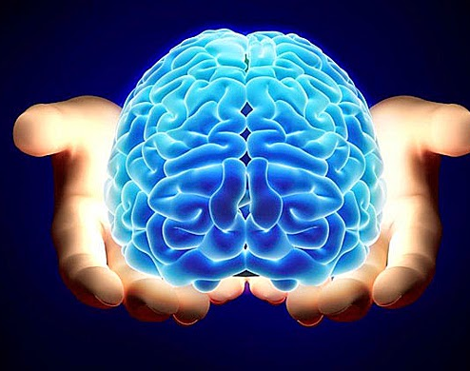
To understand our vulnerability, let's look at what our brain is like. A brain highly sensitive to threat, designed to survive, desire, hold on, and avoid pain.

Slide 14
We carry an evolutionary brain inside of us.

Slide 15
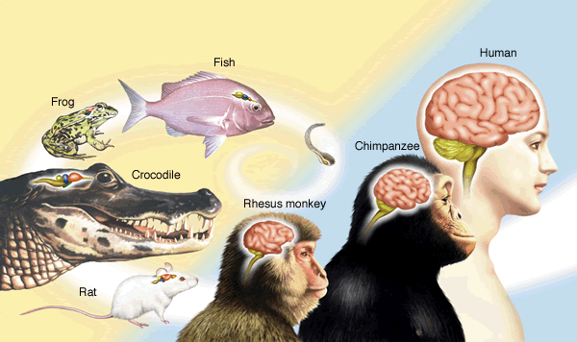
We do not live in the past but the past lives in us, in the structure of our brain.
The cerebrum has evolved over the forebrains. He didn't delete them.. they stayed with us
We have a brain ready to react to survive, especially in situations that we consider threatening (real or perceived as threatening).
WE HAVE A ZOO IN OUR HEAD

Slide 16
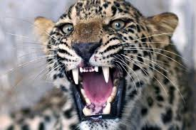
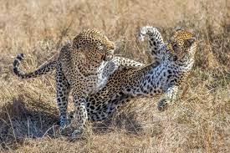
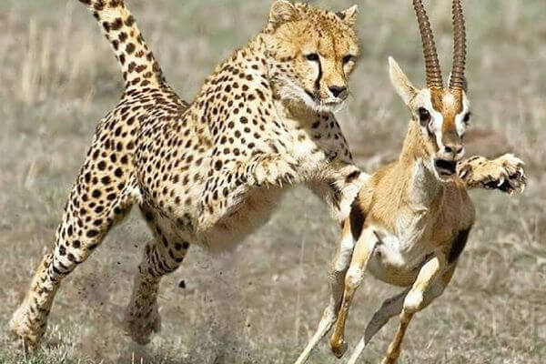
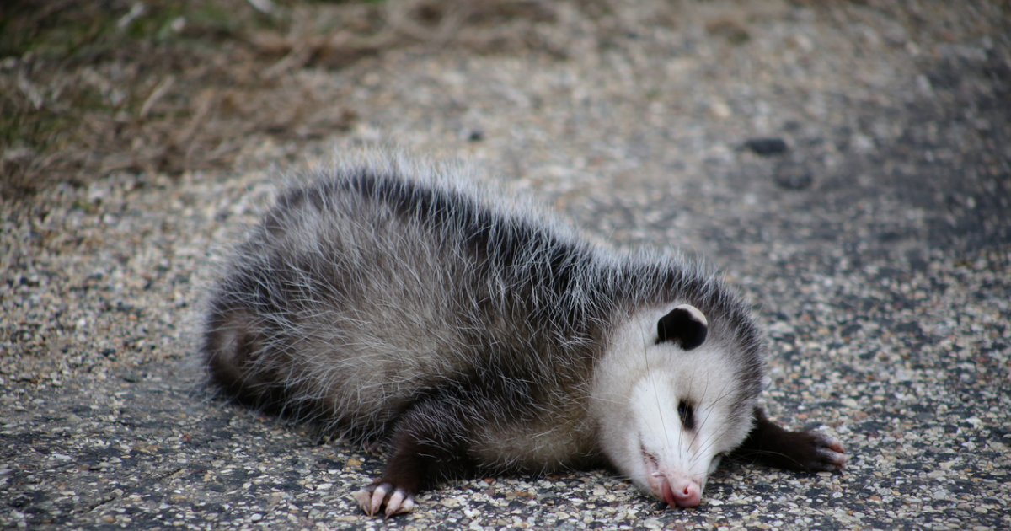
DANGER, THREAT
FIGHT
FLEE
COLLAPSE

Slide 17
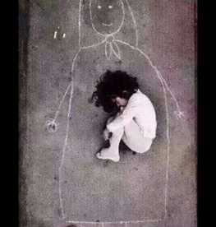
Our brain is designed to react to danger . When do we feel threatened or in danger today?

Slide 18
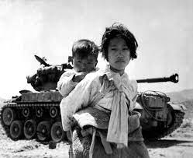
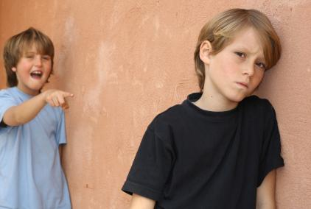
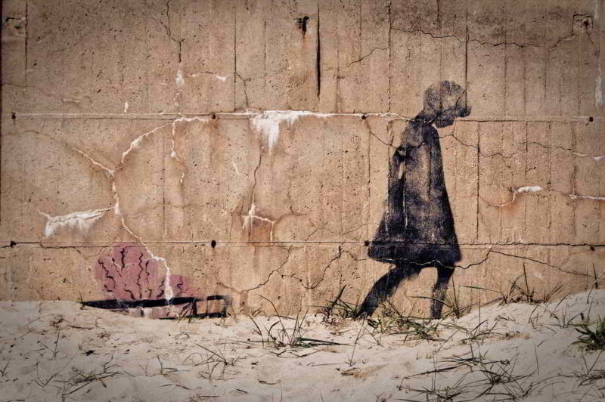
Threats to our physical integrity (we continue to hit and kill each other among humans)
Faced with the violence that we experience in the form of psychological attacks on our dignity and sense of belonging (“being part of”) when we receive derogatory comments, insults, mockery, contempt, criticism, comparisons, exclusion, discrimination, humiliation, competitiveness
And when "We are not seen"

Slide 19
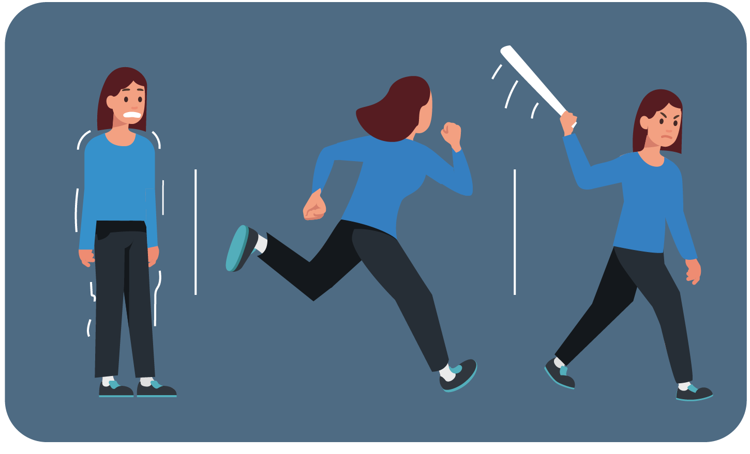
When we perceive a threat to our well-being, it is necessary to be aware of the instinctive emotional responses that are programmed in our brain and the risk of entering into an "emotional hijacking"
Fighting (driven by anger, resentment and the desire for revenge)
Flee (when we withdraw from the source of threat)
freeze
Attention
Greater sensitivity if in history itself there have been violations of our dignity, especially those who should have taken care of us, protected us

Slide 20
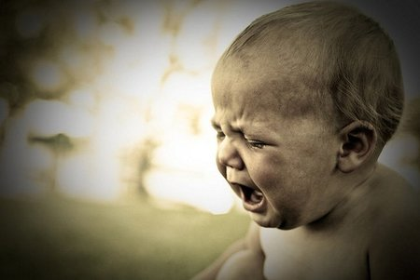
We all have the potential to do harm when we feel threatened (whether we want to or not) and if we don't learn to manage conflicts, understanding the impact of our own or others' behavior on our perceived dignity, we generate RUPTURES IN THE CONNECTION THE COVENANT IS BREAKED IN THE EVERYDAY

Slide 21
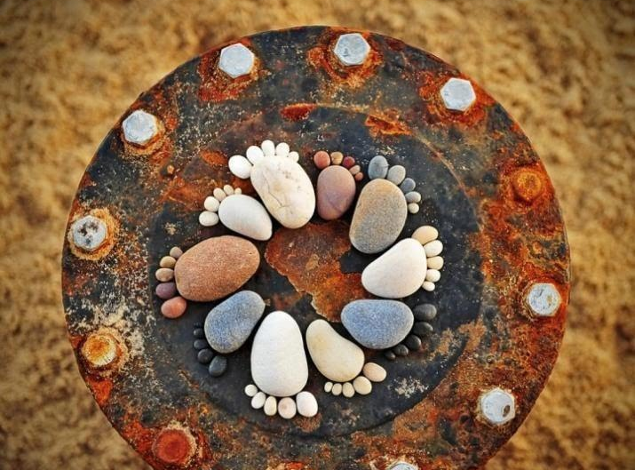
VULNERABLE PEOPLE
WALKING
JOINTS
A CHALLENGE AND A NEED

Slide 22
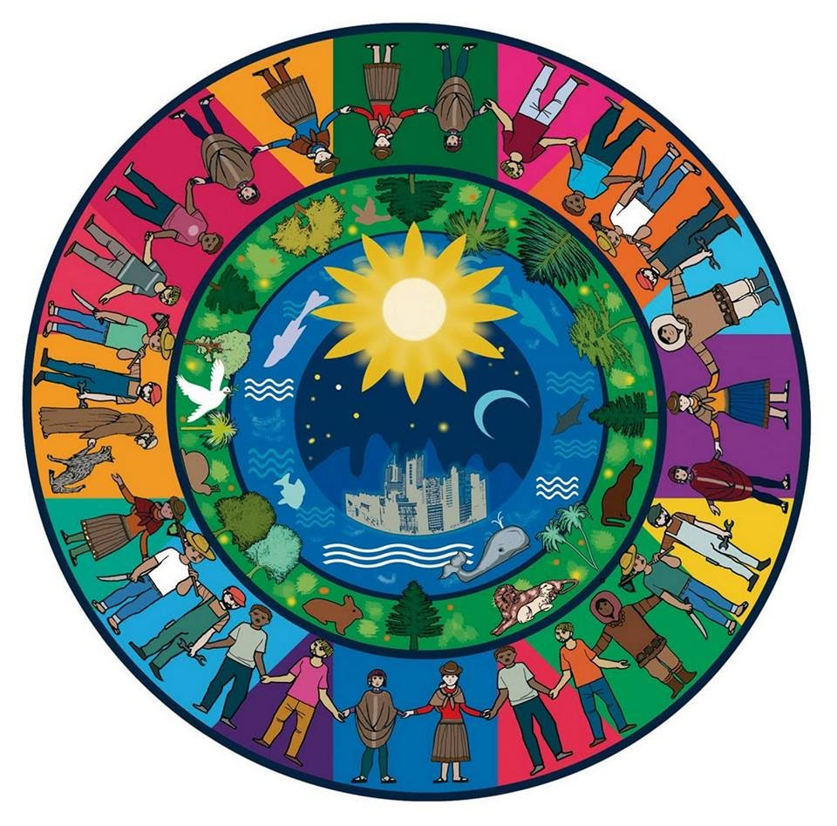
Recognize conflicts in daily life and have the wisdom to appease our "go beyond the old brain" system when it comes to treating ourselves
Invited to walk together, also with those who are different, from care to human dignity
Develop a style of coexistence in the world, which takes us from the survival model to a model of prospering together: "Watch out for the other"
Ability to give and receive dignity and to recognize dignity in all forms of life on the planet and higher forces

Slide 23
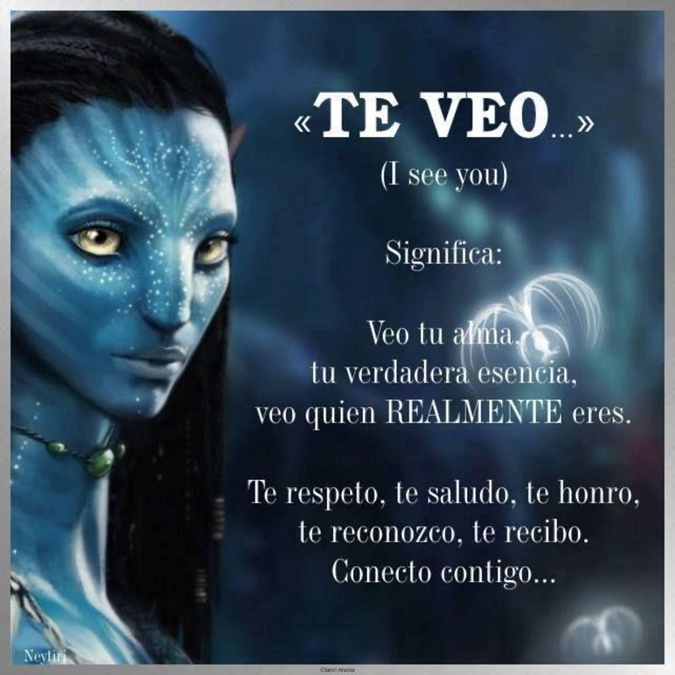
avatar movie

Slide 24
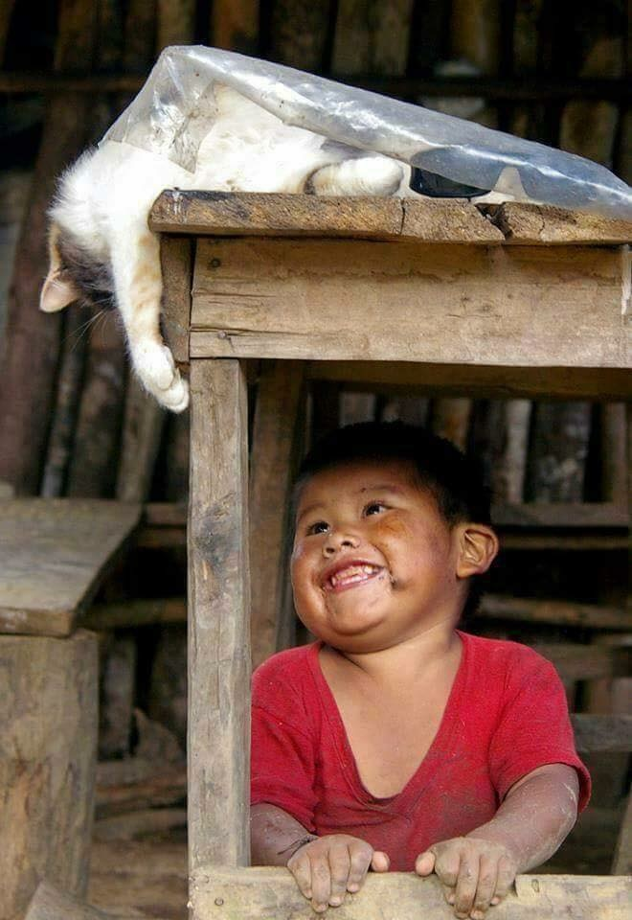
"Let's all walk together, take care of each other, take care of each other, don't hurt yourself, take care of your life, take care of your family... take care of the children, take care of the elderly (...), that this desire to take care of yourself grow in the heart"
(Pope Francisco)

Slide 25
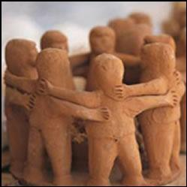
Healing relationships, which are characterized by being "repairing, supportive, containing, encouraging, patient, tolerant and firm"

Slide 26
HEAL, CALM, CONSOLE

